Slide 1
Science and Religion-
Ugly Sisters in a Suffering World?
Barry E Jones
Emeritus Professor of Engineering
Brunel University,West London
Company Director
50 years of Methodist Local Preaching

Slide 2
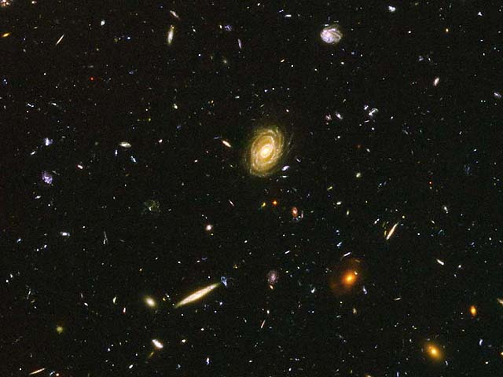

Slide 3
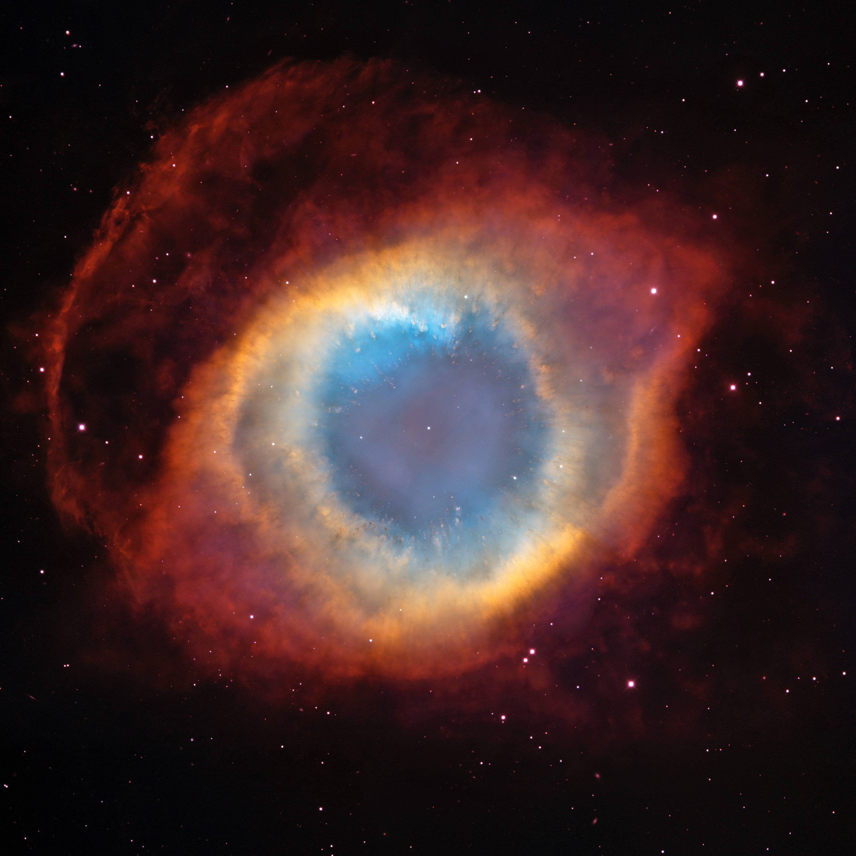
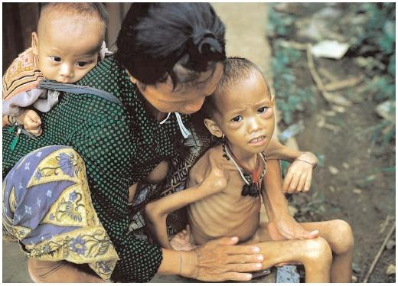
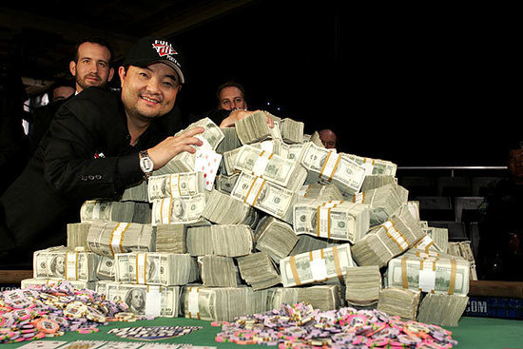

Slide 4


Slide 7


Slide 8
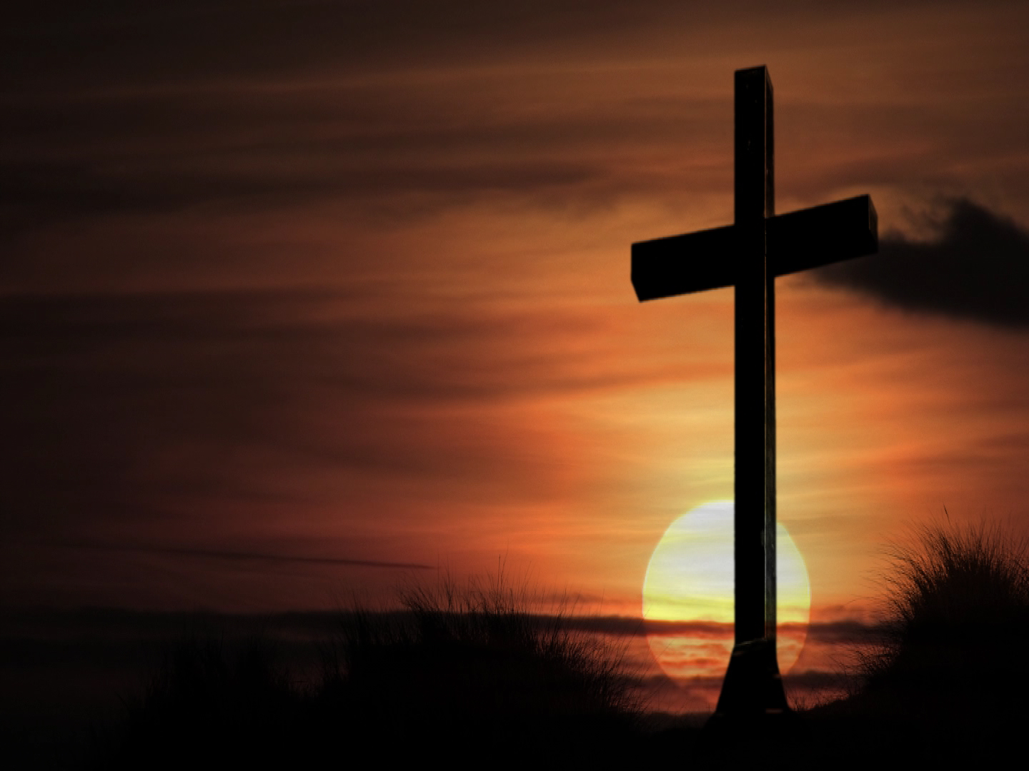

Slide 9
Quotes
“Reason,observation,and experience:the holy trinity of science”. Robert Ingersoll
“Ethical systems are completely unlike mathematics or science”. Daniel Dennett
“Science without religion is lame,religion without science is blind”. Albert Einstein

Slide 10
Quotes
“The first duty of a man is the seeking after and the investigation of truth”. Cicero
“It has been said that when human beings stop believing in God they believe in nothing.The truth is much worse:they believe in anything”. Malcolm Muggeridge
“A man lives by believing something..” Thomas Carlyle

Slide 11
Richard Dawkins
“ ..three bad reasons for believing anything.They are called ’tradition’, ‘authority’, and ‘revelation’… “
“..evidence is a good reason for believing something…”

Slide 12
Believing versus Seeking
Caricatures
Believers
=> followers
=> boundary bound
=> closet minds
=> controllers
=> nostalgic
=> suspicious
=> fearfull
=> cautious
=> narrow views
=> decide before evidence
Seekers
=> leaders
=> provisional
=> open minds
=> enablers
=> changers
=> brave visionaries
=> foolhardy
=> broad views
=> await evidence
=> experiment
=>pilgrims and travellers

Slide 14
SWOT analysis
Strengths
Weaknesses
Opportunities
Threats

Slide 15
Strengths of Science
Simple ,yet powerful methodology
Shared activity worldwide
Aims to disprove,ie seeks errors
Exploited through engineered technologies
Applicable across all areas of life
Results in major benefits to humankind

Slide 16
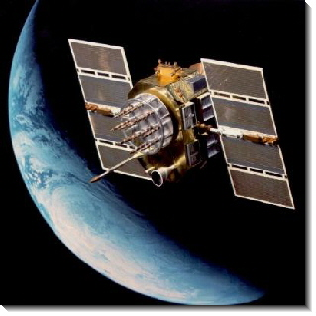

Slide 17
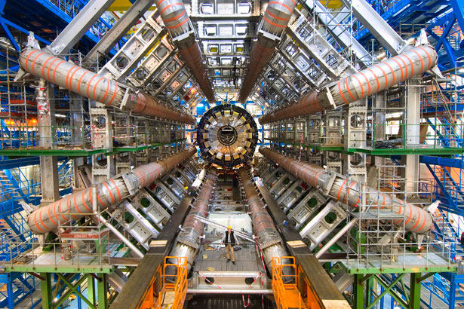

Slide 18
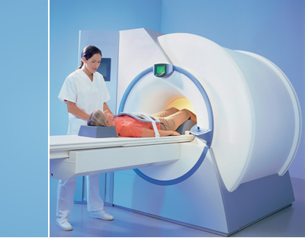

Slide 19
Weaknesses of Science
An amoral pursuit
An addictive activity
Results in evils as well as good
Transfers moral responsibility to others
Cannot deal with the supernatural
Reductionism and non-holistic
Encourages humanistic scientism
Elitist activity,poorly understood by non-practitioners

Slide 20
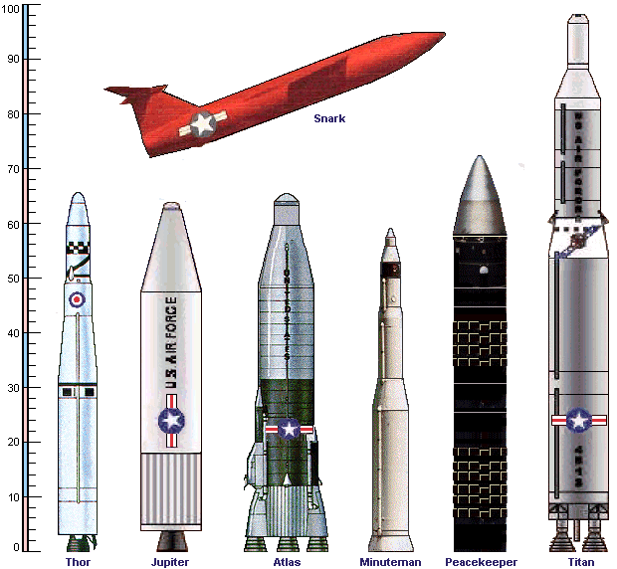

Slide 21
Soldiers in the Laboratory
~ 4 million scientists,engineers and technologists (~ 50% of total numbers worldwide) develop military technology for use of force
The arms trade contributes to conflict,human rights abuses and poverty
The UK MoD only spends ~ 6 % of its budget on conflict prevention
Urgent need to place social justice,peace and sustainability at the centre of considerations of security
Need to encourage people to avoid working on military SET and to choose civil benefits of SET

Slide 22
Opportunities for Science
In Western Europe the Biblical God and the Church are on the defensive and the influence of christians is declining fast because of rapid culture changes
Science (incl. engineering and technology) perceived as the means to solve humanity’s problems in
      Medicine --- Energy
      Safety ---Pollution
      Rubbish ---Transport
      Food --- Shelter
      Water --- etc
Science perceived as likely to provide solutions to the major problems now affecting the globe.Religion is increasingly seen as one of the problems.

Slide 23
Threats to Science
Unable to succeed in the time-frames required
Lack of technologists and engineers
Resistance to change and acceptance by the populace
Its dangerous use and diminishment of public support
Public ignorance of science

Slide 24
Unrecognised Science Faith
Assumes nature is rational and intelligble
Accepts that the universe is governed by dependable ,immutable,absolute,universal,maths laws
Takes physics to be a ragbag of rules that allows life to exist
Thus science is a faith-based belief system
Many scientists are deeply anti-rational about this,and have the idea that laws exist without reason

Slide 26
Strengths of the Biblical God
Created and maintains the good reality experienced by us
Has the compassionate character of Jesus of Nazareth
Values,recognises and strengthens us
Has personality
Seeks our well-being through love and justice

Slide 27
Weaknesses of the Biblical God
Can be violent,cruel and domineering
Inconsistent behaviour:loves and punishes
Split personality,therefore creates division amongst people
Requires sacrifices for forgiveness of sins
Requires only heavenly faith for salvation,not earthly virtuous action
Allows unwarranted suffering

Slide 28
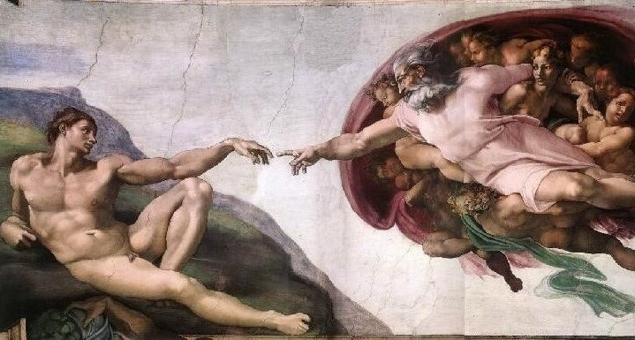

Slide 29
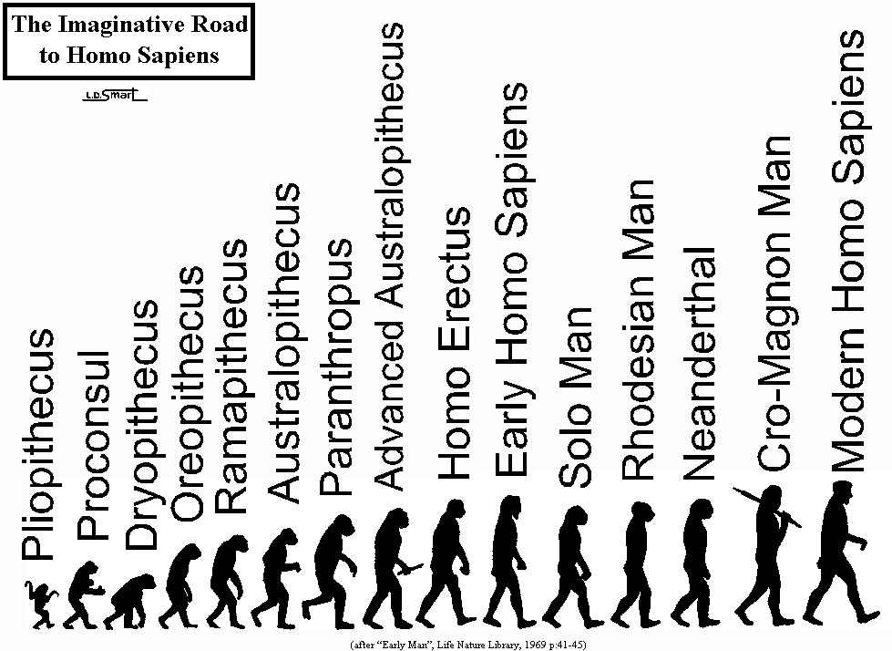

Slide 30
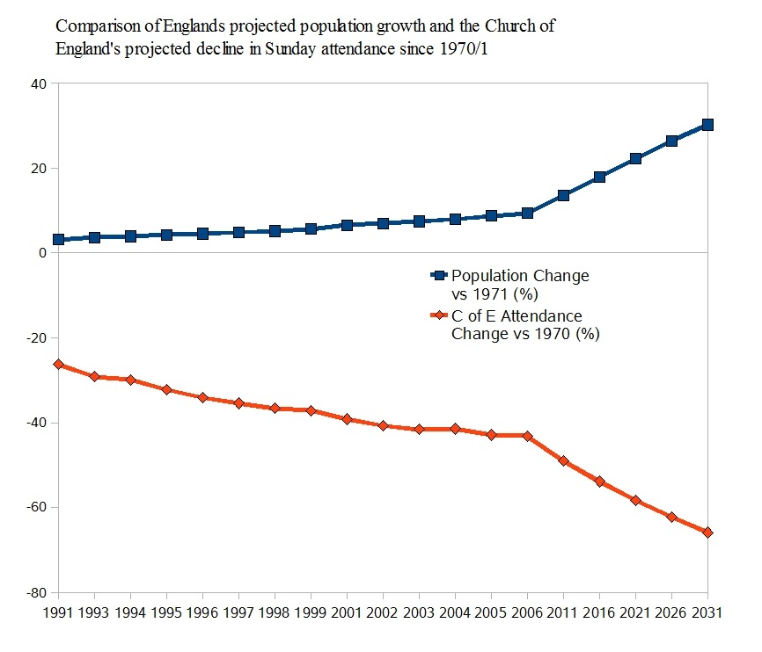

Slide 31
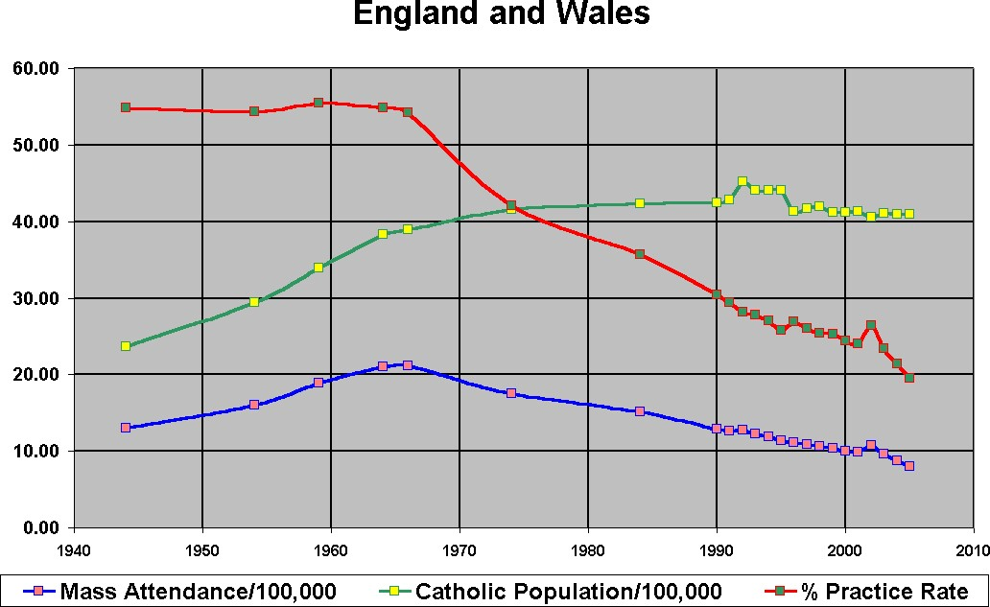

Slide 32
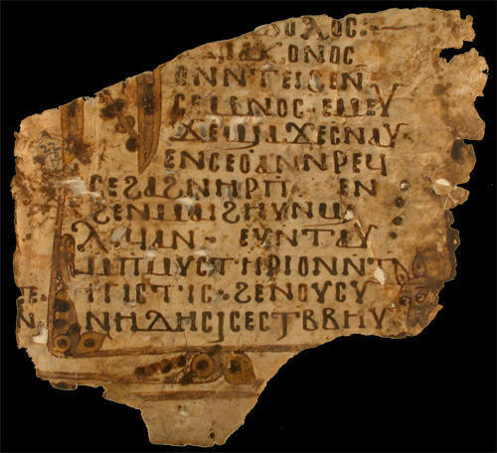

Slide 33
Opportunities for followers of the Biblical God
Greater knowledge about the historical Jesus
Rediscovery of the Jesus message “ hidden” for nearly two millenium by the institutional Church and its domineering heavenly belief dogmas
Seeking justice for all on the Earth requiring sacrifices by the powerful and the wealthy
Seeing the Creation as a precious gift for the Kingdom of God and not to be dominated by the powerful and wealthy
Finding salvation through repentance,prayer and exemplar actions for justice
The humbling of the traditional institutional Church
This Church being forced to downscale, regroup and work on the margins of society
Recapture cross-cultural evangelism
Fresh non-institutional expressions of Church outside church buildings
Seeking the goodness of God already within the diverity of non-religious individuals,groups and communities
Rapprochement with religious Jews and Muslims on the basis of a common Abrahamic Godly tradition

Slide 34
Seek and/or Believe ?
The Gospel of Thomas (not in the Bible)
The author writes that Jesus said
”Let one who seeks not stop seeking until he finds”
“If you bring forth what is within you,what you bring forth will save you”
The Gospel of John (put in the Bible)
The author writes
“ Believe that Jesus is the Messiah,the Son of God.....that you may have life”

Slide 35
Salvation through Lifestyle,Discipleship, and Witness with good Godly ideas,principles,values, practices, and personal experience
Non-violence
Reconciliation
Equality
Community and belonging
Justice
Forgiveness
Trust
Caring
Harmony
Goodness
Sense of good purpose
Truth-telling
Love
Generosity
Voluntary poverty
Sacrifice
Inclusiveness
Grace
Mutual respect
Acceptance
Relationships
Making a difference

Slide 36
Threats to the Biblical God
Worldwide mass education,secularisation , global 24/7 communication,and multiple personal social identities
Growth of cultures where individuals develop and regularly change their pick-and mix low-depth spiritualities
The difficulty of achieving harmony between religions
Increased scepticism about the supernatural
Desertion by the young
God often seen as part of the problem, not the solution
Science providing big benefits and seen as the ‘saviour’
Institutions out of favour
The churches divided,sidelined,marginalised and out of the mainstream
Traditional church memberships aged and in continuous decline
Religion under attack from atheists and materialists
The large number of nominal christians who lack commitment and are largely ignorant of the Bible
Literalist/fundamentalist reading of the Bible

Slide 38
The Creative God of Dynamic Processes
Revelations through ancient Holy Books => slow semi-static impacts/outcomes (largely driven by centralised church organisations)
Revelations through Book of Nature => rapid dynamic impacts/outcomes (largely driven by ideas of individuals)
Now the answers to “Why” and “How” questions interact
Thus answers to ultimate questions of meaning ,purpose and values needs both Religion and Science
➔ “ These two Ugly Sisters need each other for creative dynamic harmony in the global village”

Slide 39
Quotes
Science gathers knowledge faster than society gathers wisdom”. Isaac Asimov
“I almost think it is the ultimate destiny of science to exterminate the human race”. Thomas Love Peacock
“Science can purify religion from error and superstitution.Religion can purify science from idolatry and false absolutes”. Pope John Paul 11

Slide 40


